Slide 1
Book1
File created on: 06-04-2025 14:54:26

Slide 2
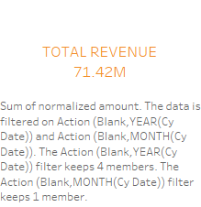

Slide 3
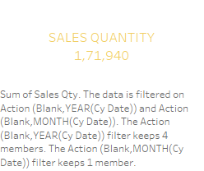

Slide 4
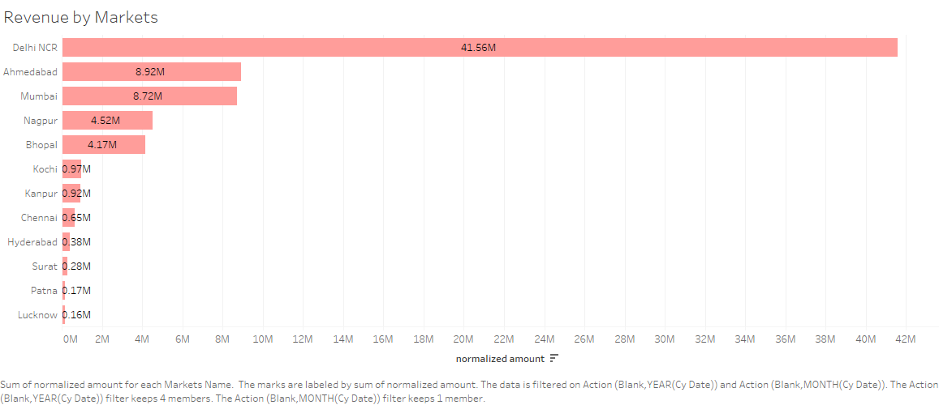

Slide 5
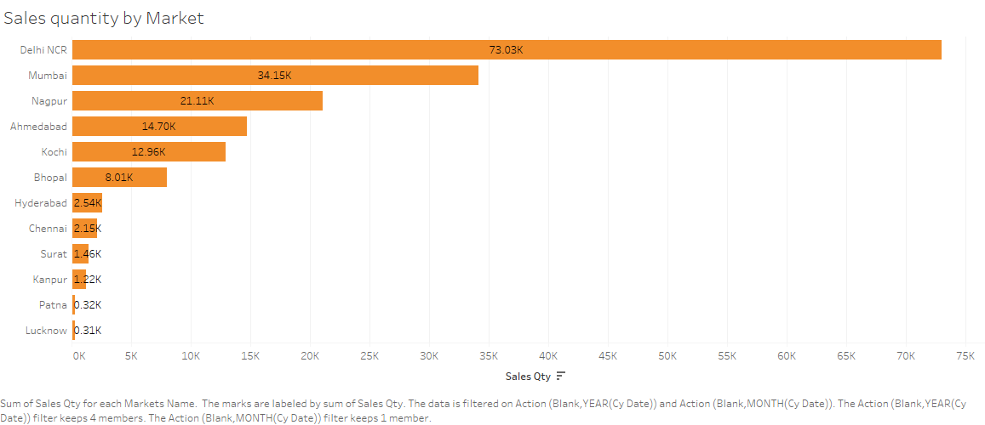

Slide 6


Slide 7


Slide 8


Slide 9
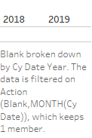

Slide 11
